Slide 2
REST stands for REpresentational State Transfer.
API is a mechanism that allows different software applications to communicate with each other over the internet or local network.
REST APIs follow specific rules and standards that enable applications and users to use HTTP requests to access and use data.
The data sent and received by a REST API is generally in the JSON (JavaScript Object Notation) format.
Data sent is a request, and the data received from the API call is called the response. Two main characteristics of RESTful APIs include:
Stateless Interactions: Each request from a client to a server must contain all the information needed to understand and process the request. The server does not store any session information about the client.
Uniform Interface: A REST API is designed to use standard HTTP methods and should be easy for any developer familiar with HTTP.

Slide 3


Slide 4
Why REST API
Scalability: Due to their stateless nature, REST APIs can handle multiple types of calls, return different data formats, and even change structurally with the correct implementation of hypermedia.
Flexibility and Portability: Data is not tied to resources or methods, allowing more flexibility in its representation. This makes REST APIs suitable for different types of applications.
Independence: The separation between client and server allows for development across various parts of an application to coincide with less dependency on each other.
light weight, highly scalable and maintainable and are very commonly used to create APIs for web-based applications.

Slide 5
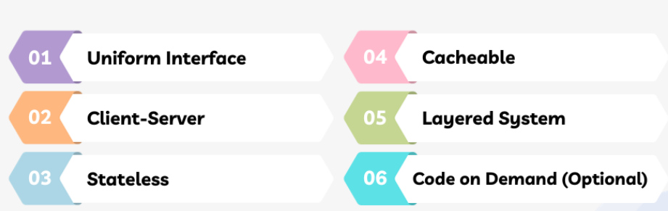
Principles RESTful Architecture
Six guiding principles RESTful architecture are:

Slide 6
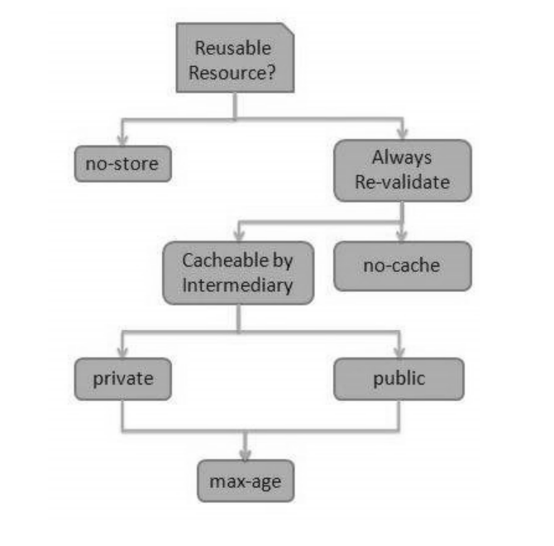
RESTful API Caching

Slide 7
REST API Methods
GET: This API method requests data from a specified resource. It should only retrieve data and should have no other effect.
POST: This API method sends data to the server for creation. It is often used when uploading a file or submitting a completed web form.
PUT: This API method updates all current representations of the target resource with the uploaded content.
DELETE: As the name suggests, this method removes/deletes a specified resource.
HEAD: Similar to GET, this method only transfers the status line and the header section.
PATCH: This method applies partial modifications to a resource.
Each method corresponds to the CRUD (Create, Read, Update, Delete) operations in database management.

Slide 8
Advantages of REST API
Simplicity and Flexibility
Platform Independence
RESt APIs are also performant and efficient since responses can be effectively cached to minimize data transfers.

Slide 9
Challenges REST APIs
The statelessness of REST can lead to larger requests since all necessary data must be included in each request. This also creates issues like:
Data Overfetching and Underfetching, which can impact performance, as multiple requests may be needed to gather all data, or excessive data may be returned unnecessarily.
Security concerns are a potential challenge, requiring proper implementation of authentication and data transfer security practices to keep data secure.
versioning of REST APIs can be complex, with changes potentially breaking backward compatibility.
The lack of a strict standard in REST implementation can lead to inconsistencies across different APIs

Slide 10
API Analytics and Monetization
Live API traffic
Time-series reports inspecting usage
Conversion funnels
Retention reports

